Slide 1
Fitt’s law

Slide 2
Fitts’ law states that the amount of time required for a person to move a pointer (e.g., mouse cursor) to a target area is a function of the distance to the target divided by the size of the target.
Thus, the longer the distance and the smaller the target’s size, the longer it takes.

Slide 3
In 1954, psychologist Paul Fitts, examining the human motor system, showed that the time required to move to a target depends on the distance to it, yet relates inversely to its size.
By his law, fast movements and small targets result in greater error rates, due to the speed-accuracy trade-off.
Although multiple variants of Fitts’ law exist, all encompass this idea.

Slide 4
For example, this law influenced the convention of making interactive buttons large (especially on finger-operated mobile devices)—smaller buttons are more difficult (and time-consuming) to click.
Likewise, the distance between a user’s task/attention area and the task-related button should be kept as short as possible.

Slide 5
The law is applicable to rapid, pointing movements, not continuous motion (e.g., drawing).
Such movements typically consist of one large motion component (ballistic movement) followed by fine adjustments to acquire (move over) the target.
The law is particularly important in visual interface design—or any interface involving pointing (by finger or mouse, etc.): we use it to assess the appropriate sizes of interactive elements according to the context of use and highlight potential design usability problems.
By following Fitts’ law, standard interface elements such as the right-click pop-up menu or short drop-down menus have had resounding success, minimizing the user’s travel distance with a mouse in selecting an option—reducing time and increasing productivity.
Conversely, long drop-downs, title menus, etc., impede users’ actions, raising movement-time demands.

Slide 6
Let’s think of Fitts’ Law as a way of measuring the difficulty level of a target activity. If you’re indoors, have a look around. Pick out five objects in the room. They could be the following:
Doorknob on the other side of the room
Your computer screen
Very tiny dot on the Artex (textured) ceiling
Bird sitting on a tree branch, 20 meters from your window
10-floor apartment block, 150 meters from your window.
Now, try pointing at your chosen objects. Which ones can you clearly point out? Is there anyone else in
the room? If so, why not ask, “What am I pointing at?”
Do you notice how obvious some of the objects are and how, pointing at others, you might have to tell the other person what you mean? In the case of our objects listed above, we might notice the following, giving them star ratings from one (very hard) to five (very easy) to indicate how easy it is to point at them.
Doorknob - ***
Computer screen - *****
Tiny dot on textured ceiling - *
Bird on branch - **
Apartment block - *****

Slide 7
The mathematical formula behind Fitts’ law, as shown in the image at the top of this article, is T (Time) = a + b log₂ (2 D (Distance)/ W (Width).
Time is the amount of time that it will take the user to complete his or her movement.
a + b: These are a little more complex. They’re “regression coefficients”, which means that we find these by observing the slope of the object.
Distance, as you might expect, is the distance between the user’s starting point and his or her end point (the target).
Width is the width of the target object.

Slide 8
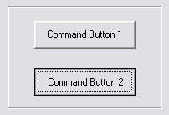
Applying Fitts’s Law to User Interface Design
The size of a target and its distance from the user’s current position within the user interface affect user experience in a number of ways. Some of the major implications for user interface design and user experience in turn are considered below:
1. Command buttons and any other interactive element in the graphical user interface must be distinguished from other non-interactive elements by size. Whilst it may seem obvious, user interface design often ignores that the larger a button is the easier it is to click with a pointing device. As interactive objects decrease in size there is a smaller surface area, requiring a level of precision that increases selection times.

Slide 9
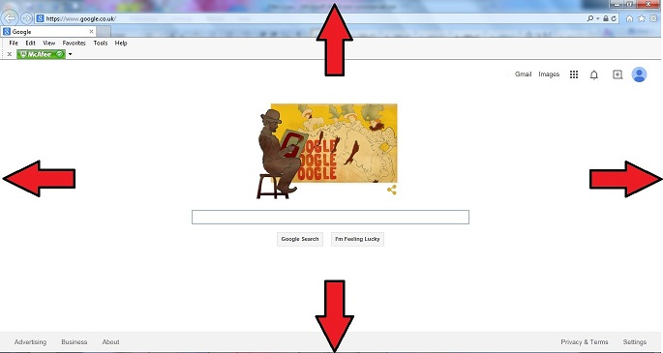
2. The outer edges and corners of the graphical user interface can be acquired with greater speed than anywhere else in the display, due to the pinning action of the screen. As the user is restricted in their movements the pointing device cannot move any further when they reach the outermost points of the screen; fixing the cursor at a point on the periphery of the display.

Slide 10
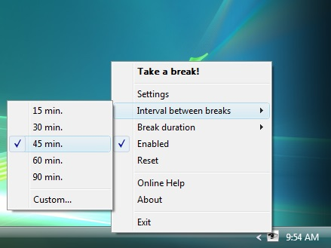
3. Pop-up menus better support immediate selection of interactive elements than dropdown menus as the user does not have to move the cursor from its current position. Therefore, graphical designs that allow the user to interact without moving help to reduce the 'travel time'.
.

Slide 11
4. Selecting options within linear menus, whether vertical (e.g. dropdown menus) or horizontal (e.g. top-level navigation), takes longer than clicking options in pie menus - where choices are arranged in a circle. Travelling distance is the same for all options in pie menus, unlike linear menus where distance increases the further along or down the list of options the user goes. In addition, the size of target areas is large in the pie menu, with the wedge-shaped buttons affording a larger margin for error when moving the cursor

Slide 12
5. Task bars impede movement through the interface as they require a more time-consuming level of precision than when options are placed on the outer limits of the screen. Although unconnected to Fitts's Law, multiple task bars can introduce a certain level of confusion or at the very least require the user to engage consciously with the screen arrangement to ensure appropriate selection

